Slide 1
Standardized Tests for College Admission

Slide 2
Overview
PSAT
SAT
SAT II
ACT
Conclusion
Notes:
Although you may think you know everything about these tests, please pay attention to the details that I will be presenting.

Slide 3
PSAT (Preliminary Scholastic Assessment Test)
Practice SAT
A shorter version of the SAT
Only 2 hours and 10 min long
3 sections: Math + Critical Reading + Writing (No essay)
Your PSAT score from your JUNIOR year counts towards the National Merit Scholarship
Notes:
Math + Reading + Writing section
The only free test

Slide 4
National Merit Scholarship Qualifying Test (NMSQT)
Based on cumulative score for all sections
-max score: 240 (20-80 points/section)
Commended students: some scholarships
Semi-Finalists: approx. 1% of students who took the test
Finalists: have to complete a separate application, have excellent grades, take real SAT
About 90% of Semi-Finalists become Finalists

Slide 5
National Merit Scholarship
9,600 scholarships offered from corporations, colleges and National Merit
Don’t need to do anything special to receive these scholarships

Slide 6
National Merit Scholarship
National Hispanic Recognition Program and National Scholarship Services
Share information about Hispanic and African American students to schools
Can put this and other National Merit honors achievement on your college application

Slide 7
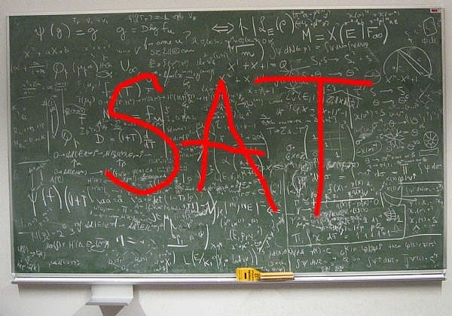
Really?
Notes:
So I know that for many of you, the SAT can look like this? The truth is, this one and other standardized tests can be studied a certain way so as to maximize correct answers. In other words, there is a process to understanding how to take this test. The first is to get to know the format better!

Slide 8
The SAT
Critical Reading, Math, Writing Skills
3 hrs and 45 min
Multiple Choice, Grid-Ins and Writing
10 different sections total

Slide 9
Critical Reading
67 Multiple Choice questions
Sentence completion, short passage reading, long passage reading

Slide 10
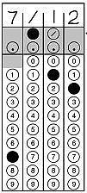
Mathematics
Arithmetic operations, algebra, geometry, statistics and probability
Multiple Choice and Grid-Ins

Slide 11
Mathematics
At the beginning of 2006, both Alan and Dave were taller than Boris, and Boris was taller than Charles. During the year, Alan grew 2 inches, Boris and Dave each grew 4 inches, and Charles grew 3 inches. Of the following, which could NOT have been true at the beginning of 2007?
(A) Alan was shorter than Boris.
(B) Alan was shorter than Charles.
(C) Boris was shorter than Dave.
(D) Dave was shorter than Alan.
(E) Dave was shorter than Charles.
http://sat.collegeboard.org/practice/answers-imagined#aiAnimTop
Notes:
http://sat.collegeboard.org/practice/answers-imagined#aiAnimTop

Slide 12
Writing Skills
Improving sentences, identifying sentence errors, improving paragraphs
25 min essay, respond to viewpoints

Slide 13
Writing Skills
People use the term "wisdom" to mean many things. They describe someone as wise if that person is intelligent, well-informed, or capable of making good decisions. These descriptions, however, are not really useful in distinguishing wise people from unwise ones. Happiness is a better measure of wisdom: a wise person is a happy person. Even the most intelligent people should not be called wise if they are not happy.
Assignment: Is it best to determine how wise people are by how happy they are? Plan and write an essay in which you develop your point of view on this issue. Support your position with reasoning and examples taken from your reading, studies, experience, or observations.

Slide 14
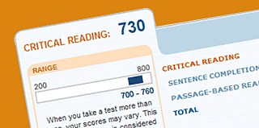
Scoring
Each section is 800 points, 2400 total
Most colleges will put together your “best test” if you take it twice

Slide 15
Scoring
Test 1: April 2014
Reading | 650
Writing | 620
Math | 700
Total | 1970
Test 2: May 2014
Reading | 720
Writing | 640
Math | 670
Total | 2030
Best Score
Reading | 720
Writing | 640
Math | 700
Total | 2060
+
=

Slide 16
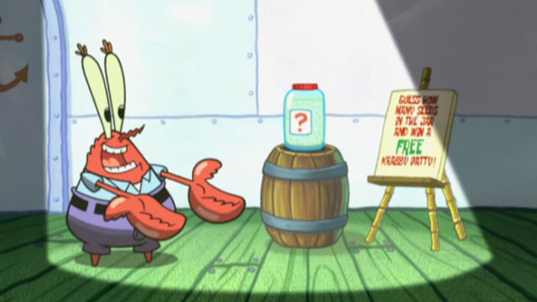
Scoring
Correction (punishment) for guessing: -1/4 point
Guess wisely
If you can eliminate even one answer choice on a question, always guess.
Notes:
There are 5 answer choices so if it is down to 4 choices, you have a ¼ chance to get it right and gain a whole point

Slide 17
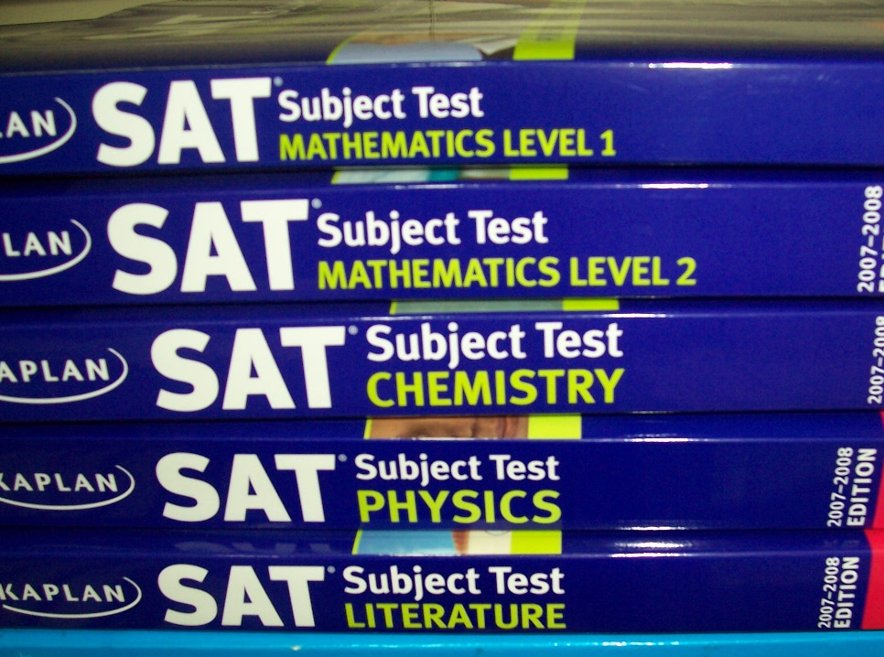
SAT II

Slide 18
SAT II
Subject tests
1 hour long each, content based
Two subject tests are required by many top-tier schools

Slide 19
SAT II Subjects
Literature
US History
World History
Math Level 1
Math Level 2
Biology Ecological
Biological Molecular
Chemistry
Physics
French (with Listening)
German (with Listening)
Spanish (with Listening)
Modern Hebrew
Italian
Latin
Chinese with Listening
Japanese with Listening
Korean with Listening

Slide 20
Taking SAT IIs
Take tests in your areas of strength
Take tests in what you want to pursue in college
Take them after you have taken a class in that subject area
If English is NOT your first language, take subject test in language of origin

Slide 21
Fee Waivers
SAT Total Cost: $51
SAT IIs Total Cost:
$24.50 (Basic Regis. Fee) + $13/test
Received from your counselor
Can receive up to two free SATs and two free SAT II sittings (up to 6 subject tests)
Notes:
That means 3 subject tests per sitting

Slide 22
Notes:
Used to stand for American College Testing, but is now simply “ACT”

Slide 23
The ACT
3 hours long
-time is a major factor
Math, English, Reading, Science
Optional Writing section

Slide 24
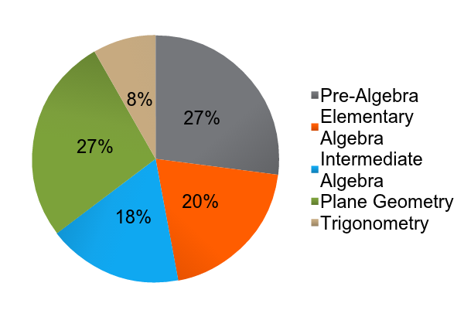
Math
60 min, 60 questions
Covers material usually learned by the end of 11th grade

Slide 25
Scoring
Scored on a 36 point scale
Each section is 36 points, total score is average
Most colleges will look at your best section scores

Slide 26
English
75 questions, 45 min
Read 5 passages and answering
Sentence structure, grammar, organization, style
http://www.actstudent.org/sampletest/english/eng_01.html
Notes:
http://www.actstudent.org/sampletest/english/eng_01.html

Slide 27
Reading
40 questions, 35 min
4 different reading selections: social studies, natural sciences, fiction, humanities
Determine main ideas, cause and effect, make comparisons, determine meaning of words/phrases in context

Slide 28
Science
40 questions, 35 min
Data representation, research summaries, conflicting viewpoints/hypotheses

Slide 29
Writing
30 min essay
Issue with two viewpoints
You can pick a viewpoint or present a new one
Optional but required by most top-tier schools

Slide 30
Writing
Educators debate extending high school to five years because of increasing demands on students from employers and colleges to participate in extracurricular activities and community service in addition to having high grades. Some educators support extending high school to five years because they think students need more time to achieve all that is expected of them. Other educators do not support extending high school to five years because they think students would lose interest in school and attendance would drop in the fifth year. In your opinion, should high school be extended to five years?

Slide 31
ACT Fee Waivers
No Writing - $34
Plus Writing - $49.50
Received from your counselor
Can use up to 2 separate waivers
Notes:
The $16.00 Writing Test fee is refundable, on written request, if you are absent on test day or switch to the ACT (No Writing) before testing begins.
score reports for 4 colleges

Slide 32
Differences Between SAT and ACT
SAT | ACT
“Aptitude Test” – measures reasoning, verbal abilities | “Achievement Test” – measures what you learned in school
3 components: Writing, Reading, Math | 5 components: English, Mathematics, Reading, Science, optional Writing
Correction for guessing | No penalty for guessing
3 hrs 45 min | 3 or 3.5 hours (with writing)

Slide 33
Which one?
Research suggests that the SAT biased against low-income students
Has been changed since then
Look at colleges’ requirements, especially top-tier schools:
- Rice: SAT and 2 SAT IIs OR ACT with Writing
- Harvard: SAT or ACT w/ Writing AND 2 SAT IIs

Slide 34
Which one?
Which practice test did you do better on?
There are free, full length tests online
Are you better at “aptitude” or “achievement”?

Slide 35
Conclusion
Do your best on the PSAT
Take the tests that align with your strengths and goals
Keep these tests in PERSPECTIVE

Slide 36
FUN TIMES
https://www.superteachertools.net/jeopardyx/jeopardy-review-game.php?gamefile=1401714881

