Slide 1
College Applications & Financial Aid

Slide 2
Importance of College
Higher salaries
Better Life skills
Opens up door (more opportunities)
Help improve community
Exposure to variety of people and experiences
Discussion
What are your plans after high school?
Will you apply to college? Why or why not?

Slide 3
College Applications
The Application
Personal Statements
High school Transcript
Extracurricular Activities
Test Scores
Letters of Recommendation
Counselor Recommendation
Interview
Notes:
http://mappingyourfuture.org/

Slide 4
The Application
Texas Common Application
https://www.applytexas.org/adappc/gen/c_start.WBX
The Common Application
https://www.commonapp.org/
Universal app?
Application Waivers
Picking a school
Safety
Reasonable
Reach
Discussion
What are some schools you are interested in?
Why do you want to go to those schools?
Homework
Write down at least 5 schools you are interested in

Slide 5
High School Transcript
Request Transcript to be sent in advance
Order extra for personal use
GPA
Upwards Trend
Keep the Grades up!

Slide 6
Test Scores
New SAT (March 2016)
out of 1600 (Reading, Writing, Math)
3 hours and 50 minutes
Writing optional, but recommended
No penalty for guessing
ACT
Out of 36 (English, Math, Reading, Science)
3 hours and 45 minutes
ACT v. ACT with Writing
SAT Subject Tests/ SAT II
Out of 800
Required in lots of Schools (relevant to major of choice)

Slide 7
Tackling Tests
Fee Waivers
Discussion
What are some study skills that you use for Test Prep?
Homework
Contact your Counselor about Fee Waivers for the SAT, SAT Subject Test, ACT, and Common Applications

Slide 8
Free Resources
SAT & ACT Test Waiver
College Application Waiver
Khan Academy
High School Library
Houston Public Library & Harris County Public Library
BrainFuse
Live help 2pm-11pm
Writing Lab
Language Lab
Preparatory Books
SAT, ACT, College Prep, Scholarships, etc
Practice Tests
Discussion
How do you study (or plan to study) for the college admission exams and/ or school?
Homework
Get a library card/ Account with the Houston Public Library (and/or Harris County Public Library
Check out college prep books
Notes:
http://houstonlibrary.org/find-it/find-library-location
http://houstonlibrary.org/research/resources-by-category/240

Slide 9
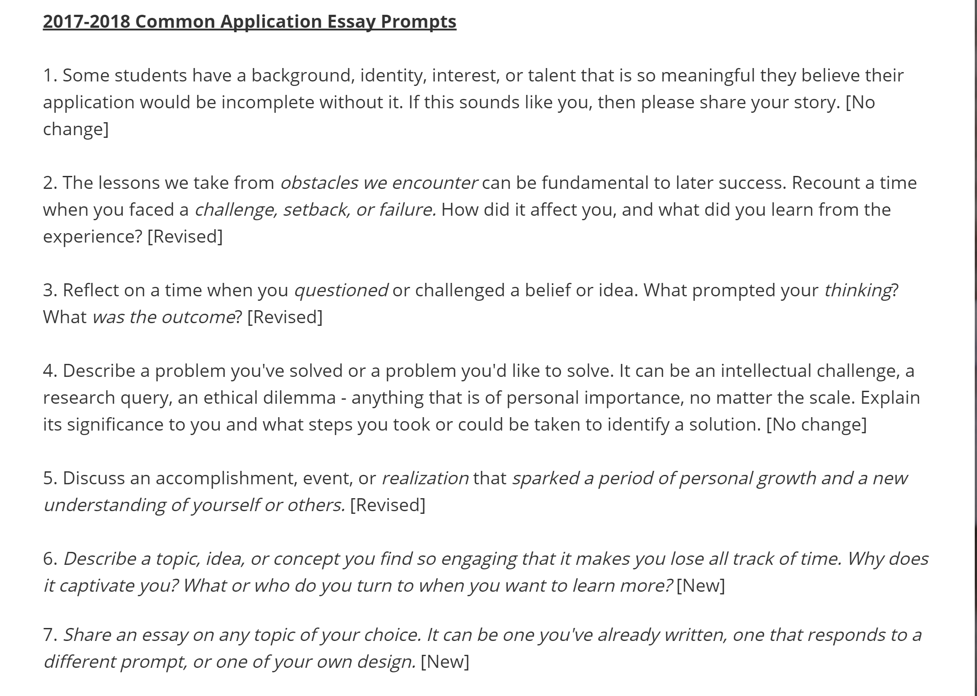
Personal Essays
Stand Out!
Show don’t tell
Clear, Focused, Organized
Revise
Ask for constructive criticism
2017-2018 Common Application Prompts

Slide 10
Extracurricular Activities
Sports
Clubs, societies & organizations
Job
Volunteering
Internships
Awards
Certifications & skills
Languages
Discussion
Write down at least 2 Extracurricular Activities you participate in.
Discuss why these activities are important to you
Homework
Create a Resume
Have a responsible Adult check it

Slide 11
Letters of Recommendation
Who to Ask
Academic Teacher
School Counselors
Supervisor
Advisor
What do they look for
leadership
Work ethic
Enthusiasm for learning
How to Ask
Give them at least 1 month before the letter is due
Early as possible (Spring of Junior year)
How to Ask (cont.)
Have a conversation with them
Provide transcript, resume, envelope with stamp for each school you apply to
Follow up a week or so prior to deadline, so colleges receive it on time
Write Thank You notes!
Discussion
Write down 3 teachers who can write a strong letter of recommendation.
Homework
Foster a great relationship with your teachers
Ask if they are willing to write you a “Strong” letter of recommendation
Notes:
Teacher: Strong letter. You want them to highlight great attributes of yourself
Counselor: Explain why you have a bad grade with school counselor

Slide 12
Interview
Optional, but recommended*
Dress Appropriately
Prepare Answers and stories for possible questions
Research the school beforehand
Why are interested in that particular school
Have questions to ask the interviewer
Take a Tour of the campus!
Discussion
What are some questions you want to ask when you visit Rice?

Slide 13
FAFSA
Who completes the FAFSA?
You and your parents!
What is the FAFSA?
Free Application for Federal Student Aid
When do you complete the FAFSA?
ASAP after October 1 of Senior High School Year
Where do you fill out the FAFSA?
Online at www.fafsa.ed.gov
Call 1-800-4-FED-AID (1-800-433-3243) and request a paper copy
Notes:
http://dream.rice.edu/financial-aid/
http://collegeapps.about.com/od/extracurricular/tp/summer-programs-science.htm

Slide 14
FAFSA
Why fill out the FAFSA
Federal Financial AID (AKA Free Money!!!)
Need Based Aid
How do I fill the FAFSA out?
gather tax returns, bank account and investment statements
Make a PIN for the FASFA online at www.pin.ed.gov
It’s a long and very important process, so start early (October 1)
Notes:
http://dream.rice.edu/financial-aid/
http://collegeapps.about.com/od/extracurricular/tp/summer-programs-science.htm

Slide 15
Need Based Aid
Expected Family Contribution (EFC) towards cost of college
100% need based aid
combination of loans, scholarships, grants, and work-study
Pell Grant
Stafford Loan
Homework: Go over FAFSA checklist with Parents
FAFSA Checklist
Social Security Number
Driver’s license number (if applicable)
Alien registration number (if not a citizen)
Records of investments
Federal Student Aid PIN (www.pin.ed.gov)
Bank statements
Record of untaxed income
Federal Tax including W2s
Notes:
http://www.thecollegesolution.com/list-of-colleges-that-meet-100-of-financial-need/

Slide 16
Other Financial Aid Options
Grants
Loans
Look at interest rates
Scholarships
National Scholarships
Questbridge, Joyce Ivy Foundation, Gates Millennium
Local Scholarships
College Merit-based Scholarships
Applications
College Application Prep
Homework
Start looking and applying to Scholarships!
Notes:
http://www.finaid.org/
http://dream.rice.edu/scholarships/
College MErit based scholarships
-call finaincal aid
-call department
-google “college” merit based scholarship

Slide 17
Summer Programs
What can you do
Research
College Prep
Volunteer
Internship
How much will this cost me?
Some are free or you get paid (esp. Research)
Stipend
Housing, Dining, Travel
Lookup organization or institution to see if has summer program or fellowship
Discussion
What do you usually do during the summer?
What are your summer plans?
Homework
Apply to summer programs!
Notes:
http://www.fastweb.com/college-search/articles/summer-programs-for-high-school-students
http://www.thecollegiateblog.org/80-free-summer-programs-for-high-school-students/
https://www.scrippscollege.edu/academy/wp-content/uploads/sites/34/Summer-Pre-College-and-Academic-Enrichment-Programs-.pdf
http://collegeapps.about.com/od/extracurricular/tp/summer-programs-science.htm

